Slide 1


Intelligent Assistant for Solution Design
Team Members : Shreesha B, Ojas Soni, Sree Nidhi L

Slide 2
Problem Statement
In the business world, meetings are held to discuss requirements, plans, and roadmaps. After these meetings, internal discussions are often needed to identify key problem statements, design solutions, recommend technology stacks, and summarize key points and action items.
This project aims to develop a Gradio-based application that allows users to upload meeting recordings (video, audio, or transcripts) and automatically generate structured reports.
The system will classify meetings as technical or non-technical, extract summaries, problem statements, and solutions, and recommend technology stacks. It will leverage Whisper for speech-to-text conversion, apply AI enhancements to solution design, and generate Markdown reports that can later be converted to PDFs.

Slide 3
Overview of Meeting Transcript Processing
Objective: Build an intelligent assistant to:
Convert uploaded video/audio (mp4, webm, mp3) or text files into transcripts.
Classify meetings as Technical or Non-technical.
Summarize discussion points, key takeaways, action items.
If Technical:
Extract problem statements, solutions, best solutions (enhanced by AI), and recommended tech stack.
Tech Stack:
Gradio for the UI.
Whisper for speech-to-text conversion (with GPU support if available).
ollama (using the qwen2.5 model) for local Large Language Model (LLM) inference.

Slide 4
Milestone
Tasks | Day 1 | Day 2 | Day 3 | Day 4 | Day 5 | Day 6 | Day 7 | Day 8 | Day 9 | Day 10 | Day 11
Research and Technology Selection
Architecture Design
Designing Scripts & Recording Meetings
Implementing File Upload & Speech-to-Text Conversion
Chunk Transcript Processing & Handling
Local LLM - Trying Different Models
Defining & Testing Different Prompts
Ordering the Prompts
Generating Structured Reports
Frontend Designing
Combining the Entire System
Testing and Debugging
Documentation

Slide 5
Contribution
Task Breakdown:
Shreesha B | Ojas Soni | Sree Nidhi L
Research and Technology Selection Local LLM experiments Chunk Handling Prompt Engineering Recording Meetings Structured report generation Testing and debugging | Research and Technology Selection Implementing File Upload and Speech-to-Text Conversion Designing Scripts Recording Meetings Prompt Engineering Testing and debugging | Research and Technology Selection Architecture Design Recording Meetings Frontend Designing Prompt Engineering Documentation System integration

Slide 6
Completed Task
Day 1,2 :
Conducted research on speech-to-text technologies, transcript processing, and LLM prompt design.
Outlined the project requirements and established an initial roadmap.
Day 3,4:
Designed the overall system architecture integrating transcription, chunking, LLM processing, and report generation.
Developed scripts and recorded meetings to gather sample data.
Implemented file upload and speech-to-text conversion using Whisper.
Documented progress and key technical decisions.
Day 5:
Developed a module to chunk long transcripts into manageable segments (4,000 words per chunk).
Implemented a 500-word overlap between chunks to maintain context continuity.
Validated and optimized chunking logic using sample transcripts.

Slide 7
Day 6,7:
Designed classification prompts to identify meeting types (Technical vs. Non-technical).
Crafted extraction prompts for both scenarios to capture summaries, key points, action items, and (for technical meetings) problem statements and solutions.
Integrated the local LLM (Mistral via Ollama) to process transcript chunks.
Tested and refined prompts to ensure accurate extraction of required information.
Day 8,9:
Developed functions to aggregate individual chunk outputs into coherent summaries and details.
Created modules to generate structured Markdown reports, later converted to PDF.
Integrated error handling and debugging processes to ensure reliable report generation.
Day 10:
Combined all modules into an end-to-end system with seamless workflow.
Enhanced the user interface (using Gradio) for intuitive file uploads and report displays.
Performed extensive testing with various file types.
Experimented with different models and options in ollama, and finalized qwen2.5 model.

Slide 8
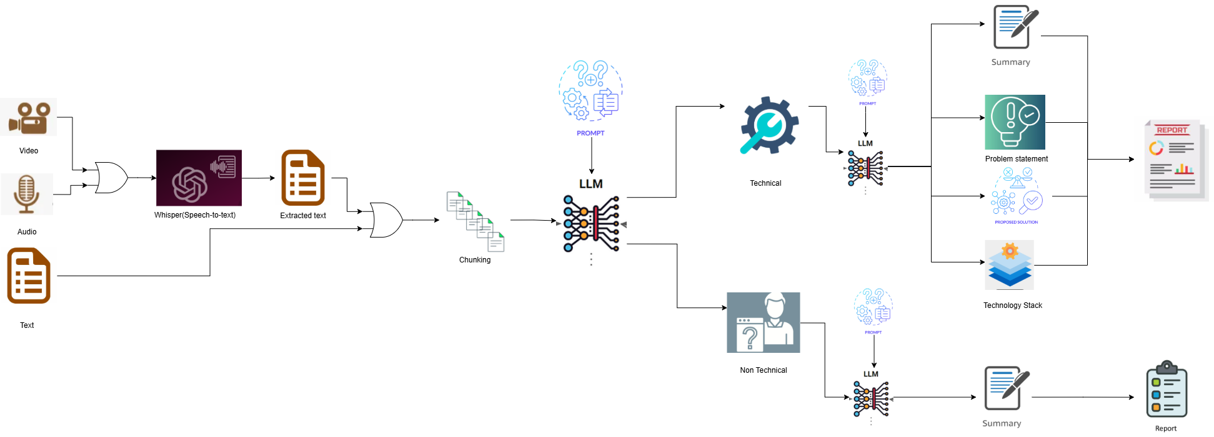
Architecture Diagram

Slide 10
Chunking, Model, and Prompt Design
Chunking:
Chunk size: 4000 words
Overlap: 1000 words
Reason:
Large context windows can exceed model limits or degrade performance.
4000 words is a safe chunk size for many modern LLMs, balancing context size with memory usage.
1000-word overlap helps maintain continuity between chunks so the model doesn’t lose context at chunk boundaries.
Model:
Currently using qwen2.5 via ollama.

Slide 11
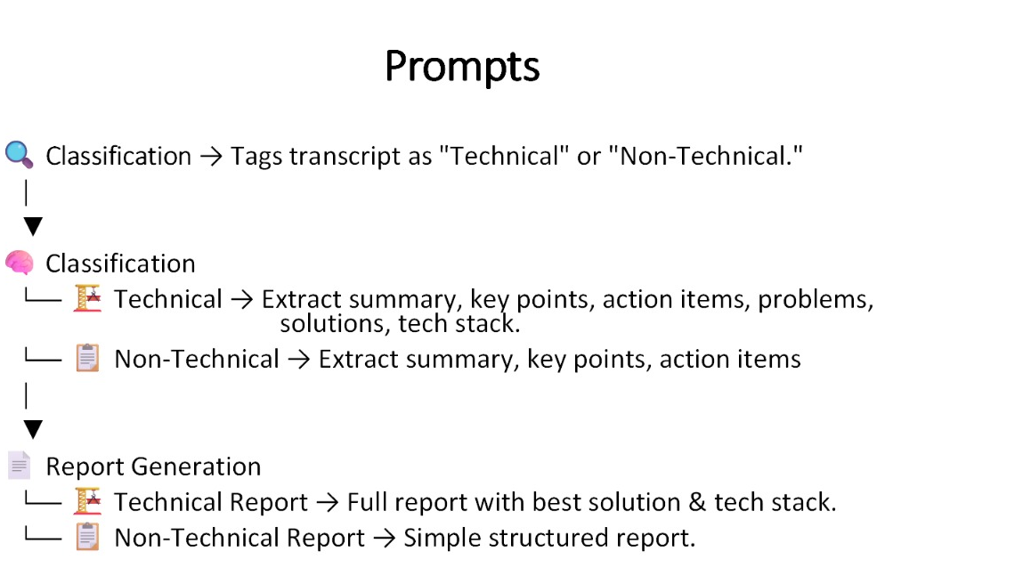

Slide 12
Defining & Testing Different Prompts
Fine-tune the LLM’s responses by crafting various prompts (e.g., classification prompts, extraction prompts, final report prompts).
Approach:
Created multiple prompt variants.
Tested each on sample transcripts to check accuracy, completeness, and tone.
Settled on a final set of prompts that reliably extract meeting details and generate structured reports.

Slide 13
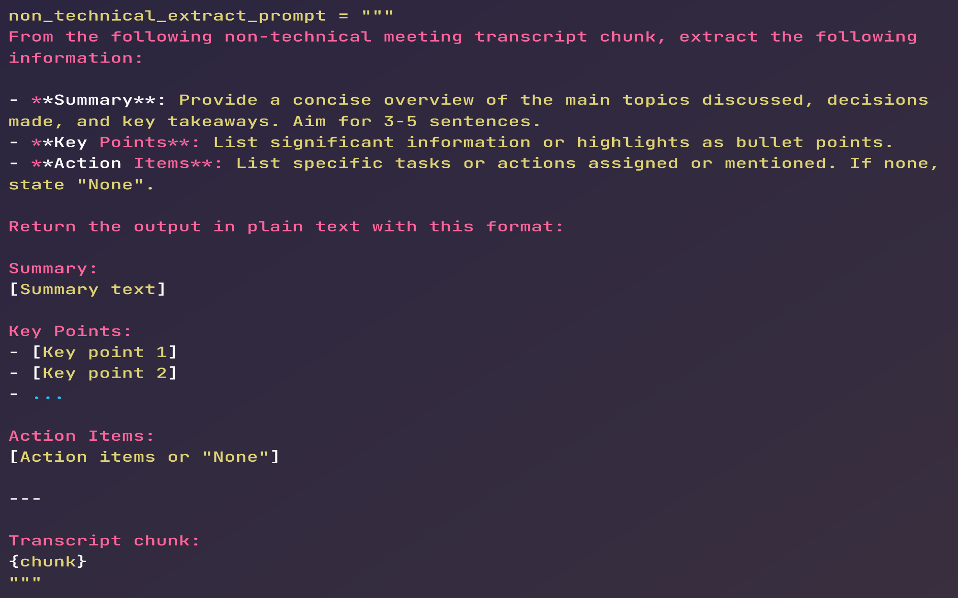
Prompt for non-technical chunk extraction

Slide 14
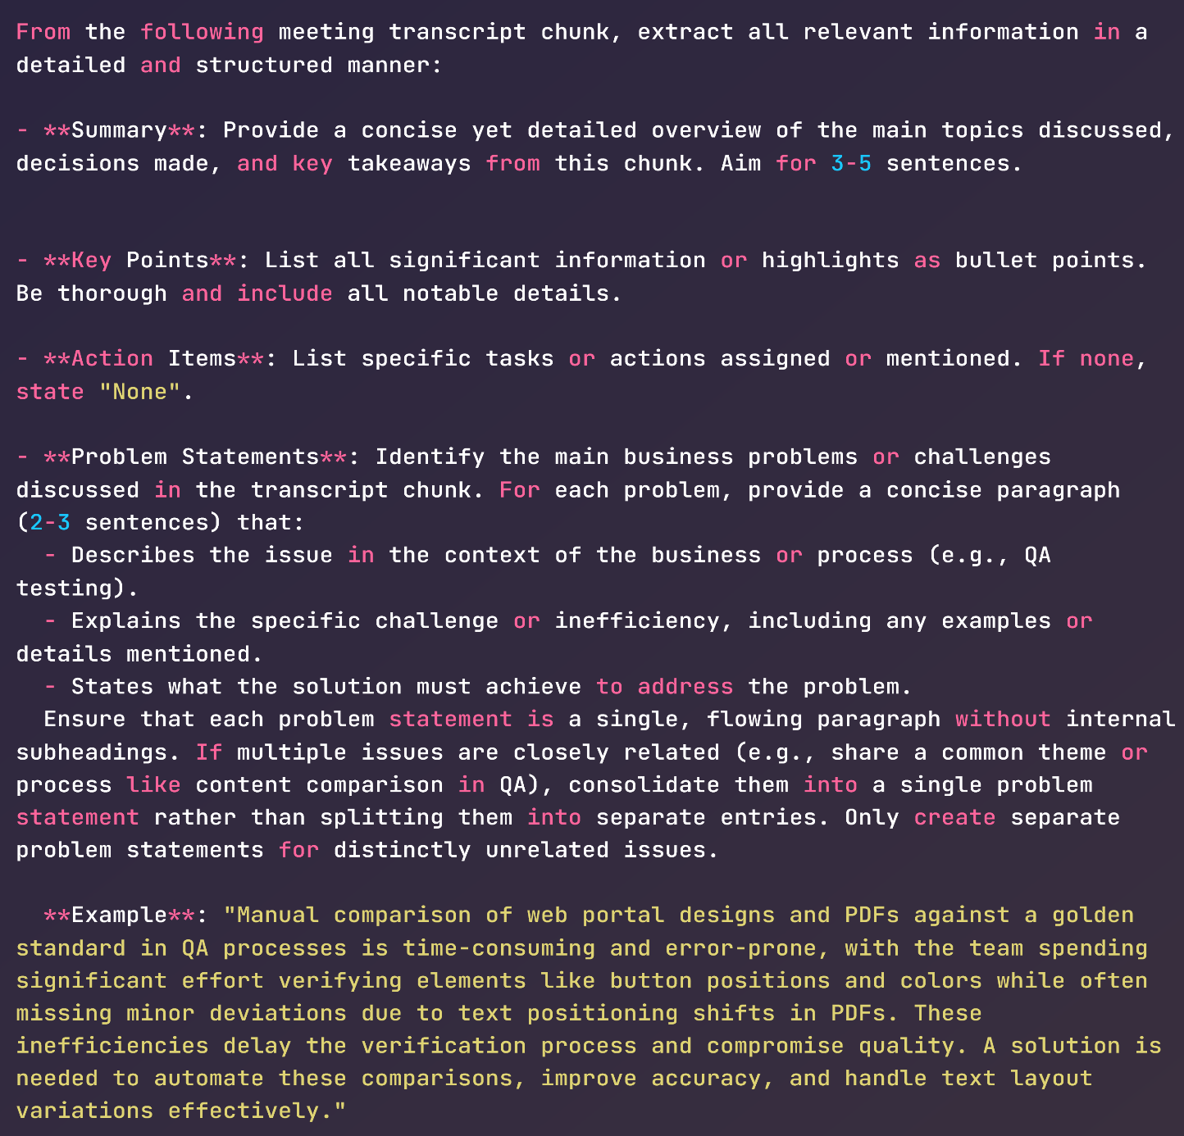
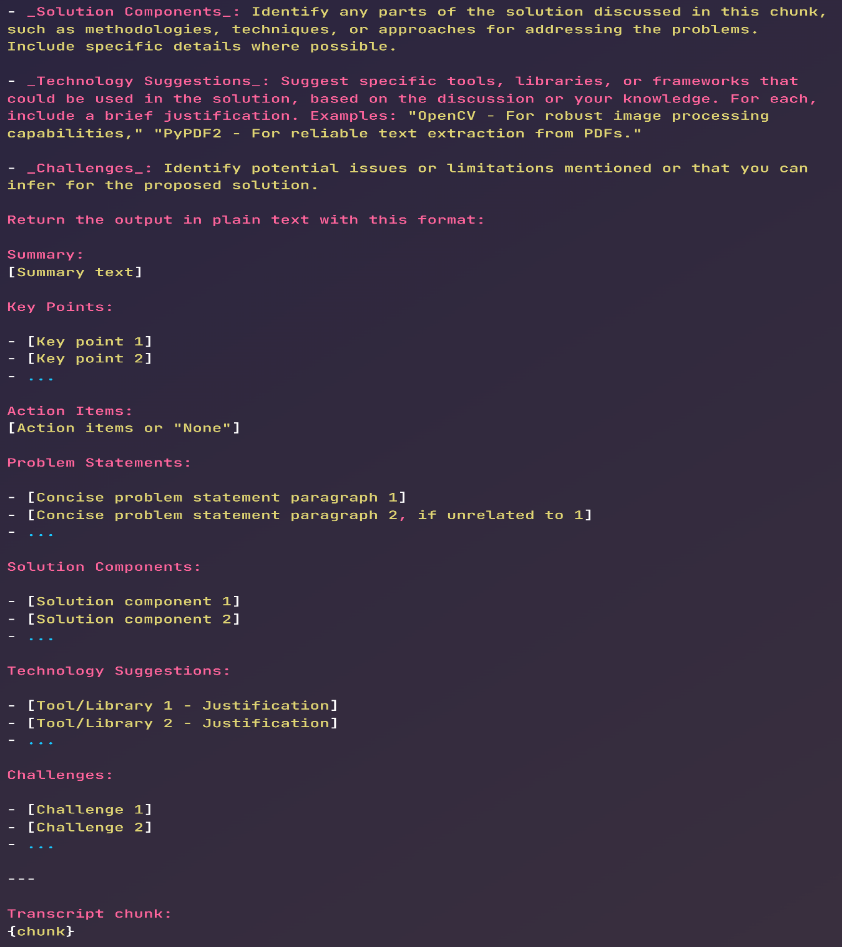
Prompt for technical chunk extraction

Slide 15
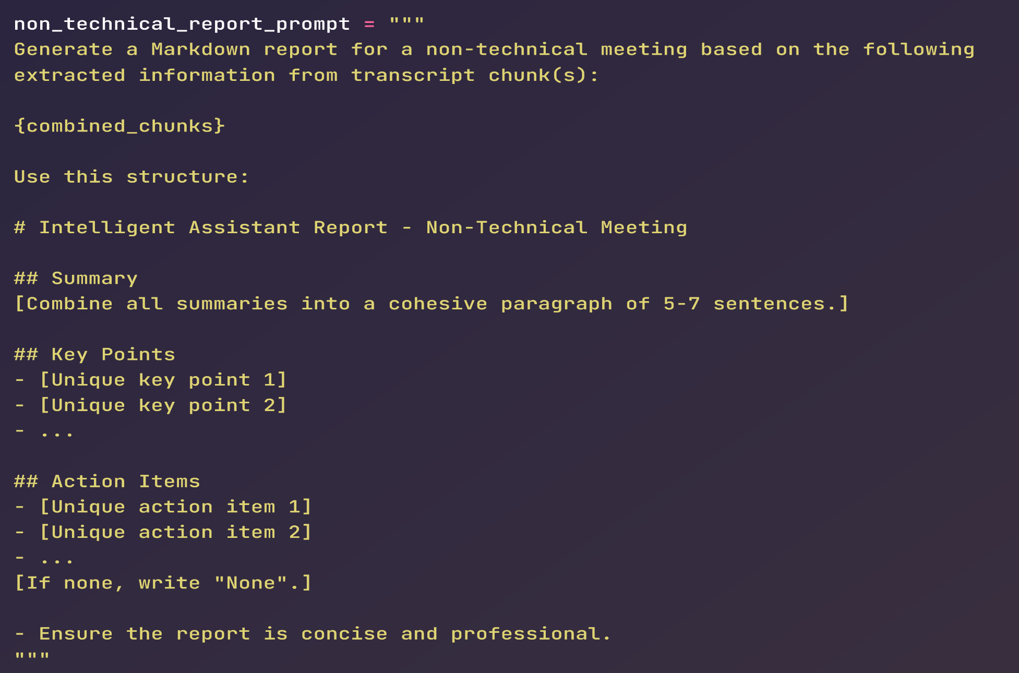
Prompt for non-technical report generation

Slide 16
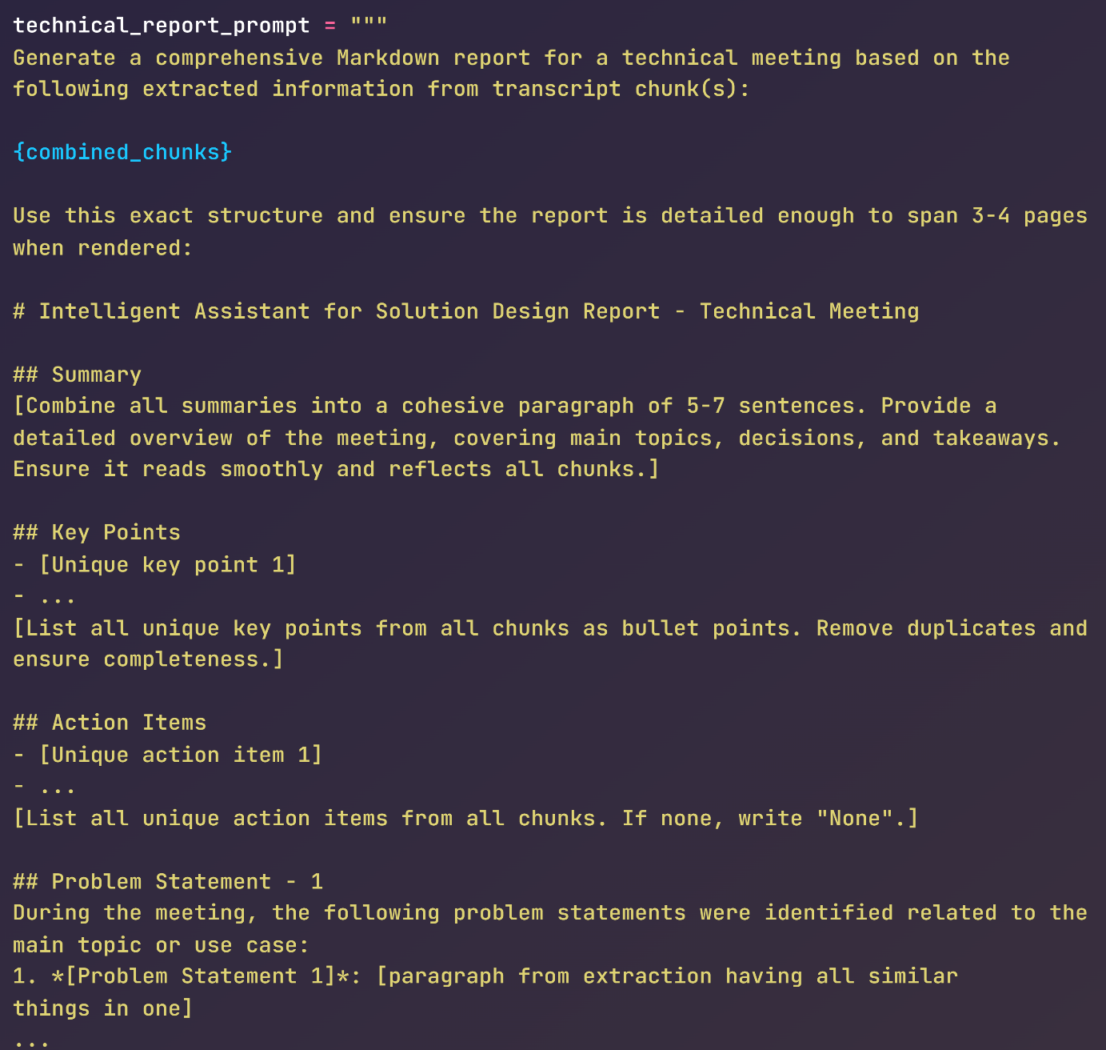
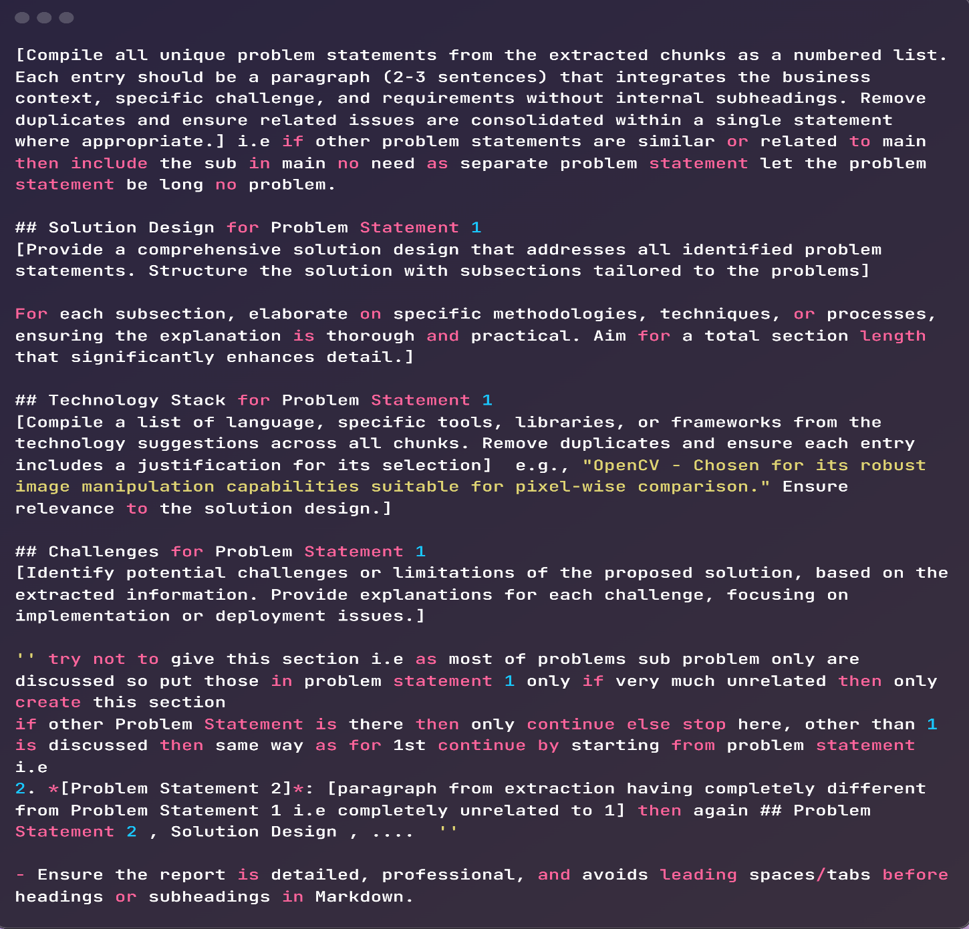
Prompt for technical report generation

Slide 17
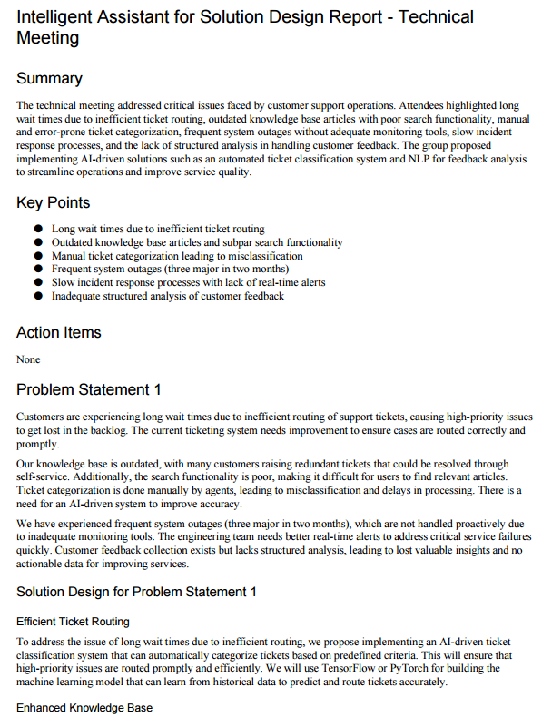
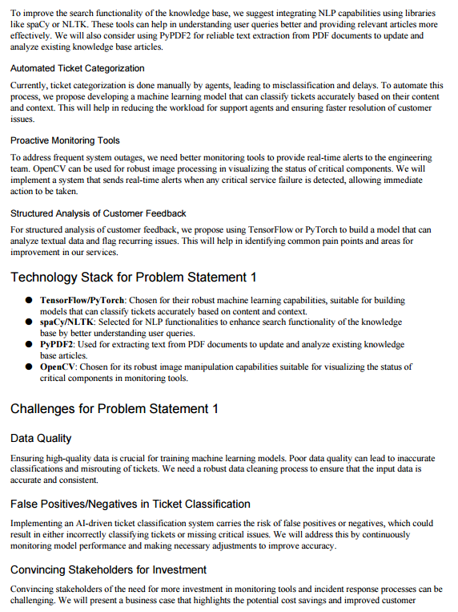

Slide 18
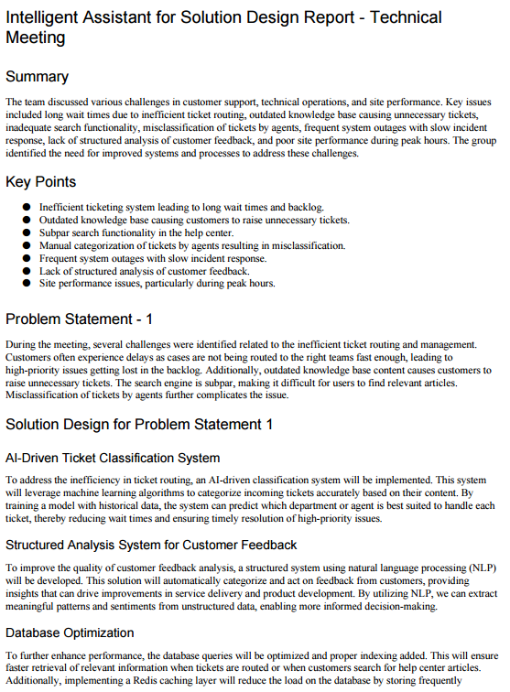
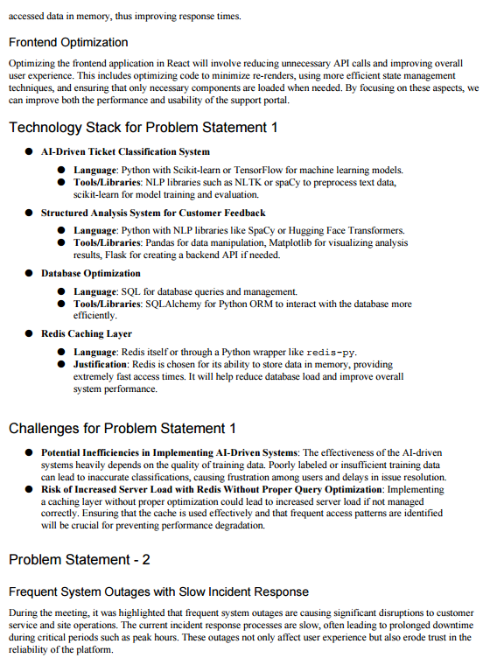

Slide 19
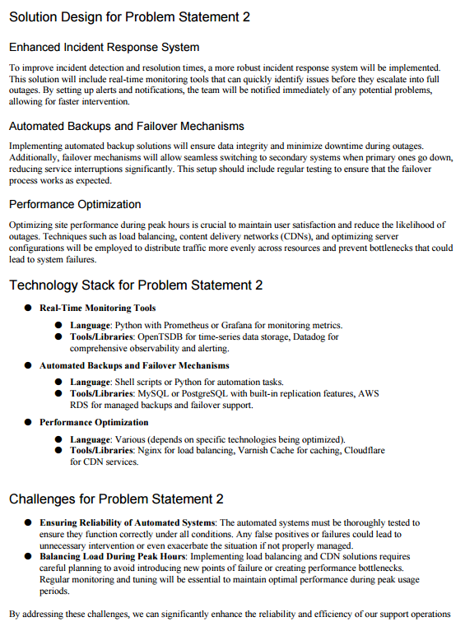

Slide 20
Conclusion
Seamless Integration – Combined speech-to-text, chunking, LLM processing, and report generation into a unified system.
Structured Workflow –transcription → chunking → classification → extraction → aggregation → report generation.
Robust Error Handling – Ensured reliability at every stage.
Optimized Model Selection – Tested multiple LLMs; finalized Qwen2.5 for best performance.
Automated Report Generation – Created well-structured Markdown/PDF reports for technical & non-technical meetings.

Slide 21
Thank you

